Slide 1


Slide 2

VIT
Topic/Course
Sub-Topic (Example: name of college)

Slide 3

Data interpretation

Slide 4

Data interpretation
Data Interpretation:
Data Interpretation or DI refers to the implementation of procedures through which data is reviewed for the purpose of arriving at an inference. Data can be obtained from multiple sources e.g. data from running of industries, census population data etc. Interpreting data requires analyzing data to infer information from it in order to answer questions.
Data can be provided in a number of formats viz:
Bars, tables, line graphs, pie graphs.

Slide 5
Data interpretation
Bar Graphs:
A bar graph or bar chart represents explicit data with rectangular bars. The heights and lengths of these bar graphs are proportional to the values of data they represent.
There are two types of bar graph, one is called horizontal bar graph and other is called vertical bar graph.
The important thing to remember is that the longer the bar, the greater its value.
In a nutshell, we can compare easily different sets of data between different groups with the help of bar graph.

Slide 6
Data interpretation
Tables:
In tables, data is described in the form of rows and columns.
In DI table's questions, we are required to read data from table/tables analyze the data and answer the questions asked on the basis of the given data.

Slide 7
Data interpretation
Line Graphs:
A line graph basically is used to visualize values over a certain time period.
It is basically used to change over time as various points of data connected by straight line on two axes.
It helps to determine the relationship between two sets of values; and also one data set is always dependent on the other set.

Slide 8
Data interpretation
Pie Charts:
Pie charts are circular shaped graphs which are divided into sectors to represent numerical proportions.
In a pie chart, the central angle of a particular sector is proportional to the quantity it represents.
In other words, we can say a Pie Chart resembles a Pie in which a circle is cut in various sized sectors from center to the boundary.
In simple words, the bigger the sector, the higher the proportion.

Slide 9
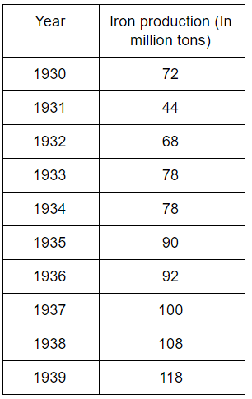
Question 1-3
Directions: The following table represents the productions of Iron from 1930 to 1939. Refer the table to answer the questions that follows.

Slide 10
Question 1
The production in the year 1930 is what percent of the total production from 1930 to 1939?
A)
9.6%
B)
12.3%
C)
8.5%
D)
7.6%
Notes:
Answer: C
Production in 1930 = 72 million tons Total production = 848 miliion (72/848) * 100 = 8.49% = 8.5%

Slide 11
Question 2
The percent jump in Iron production was highest in which of the following consecutive odd years?
A)
1933 and 1935
B)
1935 and 1937
C)
1937 and 1939
D)
1931 and 1933
Notes:
Answer: D
The highest increase between any two consecutive odd year is 34 million tons, from 1931 to 1933

Slide 12
Question 3
The least difference in production of iron (million tons) in any two successive years is ________.
A)
0
B)
2
C)
4
D)
6
Notes:
Answer: A
The least difference is zero.

Slide 13
Question 4
The greatest difference in production of iron (million tons) any two successive year is _________.
A)
32
B)
28
C)
24
D)
16
Notes:
Answer: B
The greatest difference in production between any two successive year is 28 million 1930 and 1931

Slide 14
Question 5
The production in the year 1930 is what percent of the total production from 1935 to 1939?
A)
18%
B)
14%
C)
12%
D)
18%
Notes:
Answer: B
Production in 1930 = 72 million tons Total production = 508 million (72/508) * 100 = 14.17 %

Slide 15
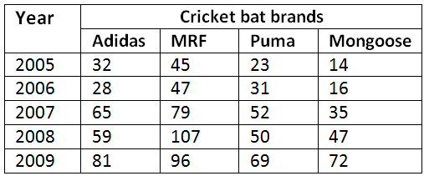
Question 6-8
Directions for the questions:
The following table gives the sales of different brands of cricket bats sold over a five year period.
Table: Cricket bats (in ‘000s) sold all over the world from 2005 to 2009

Slide 16
Question 6
Which brand recorded a continuous increase in sales between the years 2005 & 2009?
A)
Adidas
B)
Puma
C)
MRF
D)
Mongoose
Notes:
Answer: D
Continuous sales was only shown by the brand Mongoose, as we can see from the table. The values never decreased at any point of time.

Slide 17
Question 7
In which year was the total sale of bats the highest?
A)
2007
B)
2009
C)
2008
D)
2005
Notes:
Answer: B
Total sales of bats were highest during the year 2009. For finding total sales during an year, we need to add row wise.

Slide 18
Question 8
What is the difference in the number of MRF bats sold in 2006 and 2008?
A)
50
B)
60
C)
60000
D)
6000
Notes:
Answer: C
The number of MRF bats sold in 2006 - 47,000Number of MRF bats sold in 2008 - 107,000
Difference = 60,000

Slide 19
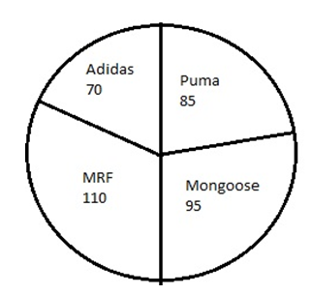
Question 9-10
Directions for the questions:
Study the following pie chart, which shows the sales of different cricket bats in 2012.
Chart: Sales of different cricket bats in the year 2012.

Slide 20
Question 9
What percentage of the total bat sales is Adidas sales?
A)
70%
B)
29.4%
C)
30%
D)
19.4%
Notes:
Answer: D
In the Pie chart Adidas sales is 70, and total bat sales is 360. Therefore percentage of bat sales of Adidas branded bats = 70/360 * 100 = 19.4%

Slide 21
Question 10
By what percentage is the sale of MRF bats greater than that of Puma bats?
A)
19.4%
B)
25%
C)
29.4%
D)
50%
Notes:
Answer: C
Sales of MRF bat = 110Sales of Puma bat = 85
Difference between Puma and MRF = 25
So, (110-85)/85 * 100 = 29.4%
MRF sales is 29.4% greater than PUMA.

Slide 22
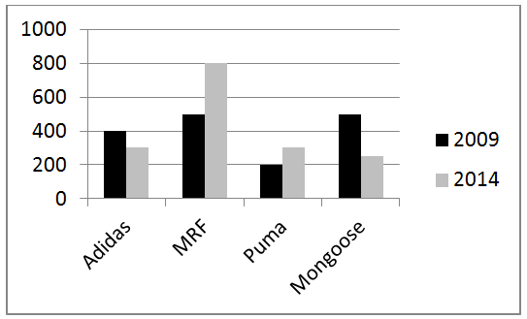
Question 11-13
Direction for questions:
The sales of different cricket bats in 2009 and 2014 are shown in the following bar graph.
Chart: Sales of four different cricket bat brands in 2009 and 2014

Slide 23
Question 11
What is the average sales of different cricket bats sold in the year 2009?
A)
1600
B)
600
C)
400
D)
500
Notes:
Answer: C
Average sales during an year is total sales divided by number of brands.Total sales of bats during the year 2009 is 1600(400+500+200+500)
Therefore the average is 400

Slide 24
Question 12
Find the percentage increase in the sales of MRF bats in 2014 over 2009.
A)
60%
B)
6%
C)
30%
D)
0.6%
Notes:
Answer: A
Sales of MRF bats in 2009 - 500Sales of MRF bats in 2014 - 800
Therefore percentage increase in sales of MRF bats is (800-500)/500 * 100 = 60%

Slide 25
Question 13
From 2009 to 2014, which brand has seen the highest percentage change in sales?
A)
Puma
B)
Mongoose
C)
MRF
D)
Adidas
Notes:
Answer: C
Percentage change in the sales of Adidas bats from 2009 to 2014 - (300-400)/400 * 100 = 25% decrease
Percentage change in the sales of MRF bats from 2009 to 2014 - (800 - 500)/500 * 100 = 60% increase
Percentage change in the sales of PUMA bats from 2009 to 2014 - (300 - 200)/200 * 100 = 50% increase
Percentage change in the sales of Mongoose bats from 2009 to 2014 - (250-500)500 * 100 = 50% decrease

Slide 26
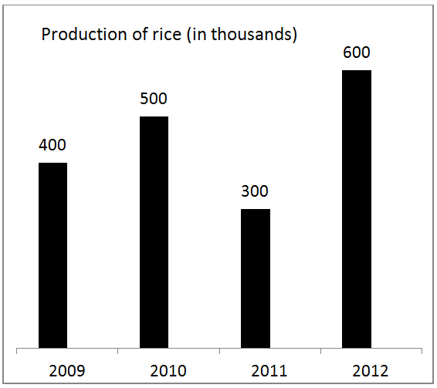
Question 14-15
Directions for the Questions:
Answer the questions based on the graph given below.

Slide 27
Question 14
From the above graph, what is the percentage increase in rice production in 2012 over 2010?
A)
40%
B)
20%
C)
15%
D)
13%
Notes:
Answer: B
Rice production in 2010 is 50,000Rice production in 2012 is 60,000
The percentage increase is (60000-50000)/50000*100 = 20%

Slide 28
Question 15
Which of the given years has shown the maximum rice production?
A)
2010
B)
2011
C)
2012
D)
2009
Notes:
Answer: C
As obvious from the graph the maximum production in rice is during the year 2012.

Slide 29

THANK YOU

